Slide 1
Chapter 4
Probability: The Study of Randomness
Lecture Slides
Introduction to the Practice of Statistics
Tenth Edition
David S. Moore George P. McCabe
Bruce Craig

Slide 2
Chapter 4
Probability: The Study of Randomness
4.1 Randomness
4.2 Probability Models
4.3 Random Variables
4.4 Means and Variances of Random Variables
4.5 General Probability Rules

Slide 3
4.1 Randomness
The language of probability
Thinking about randomness
The uses of probability

Slide 4
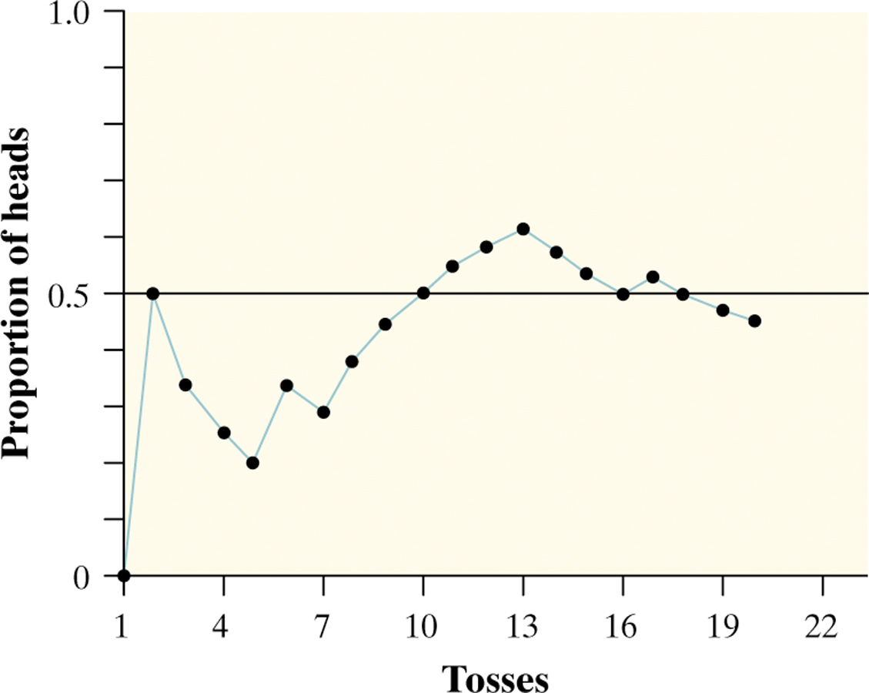

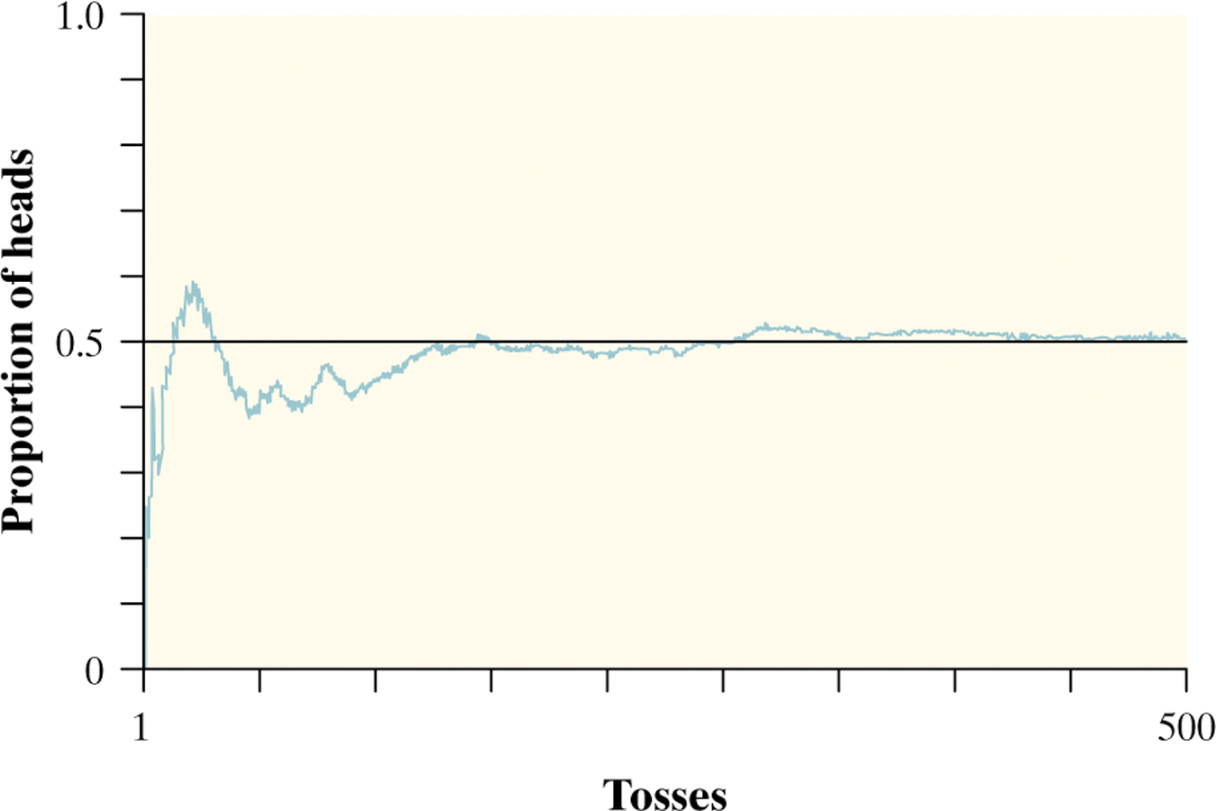
The Language of Probability
Chance behavior is unpredictable in the short run but has a regular and predictable pattern in the long run.
A phenomenon is random if individual outcomes are uncertain, but there is nonetheless a regular distribution of outcomes in several repetitions.
The probability of any outcome of a random phenomenon is the proportion of times the outcome would occur in a very long series of repetitions.

Slide 5
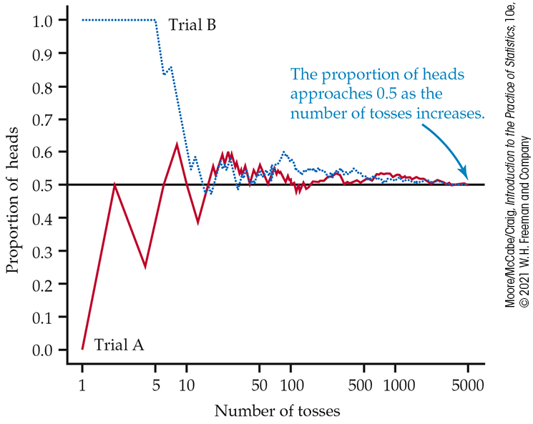
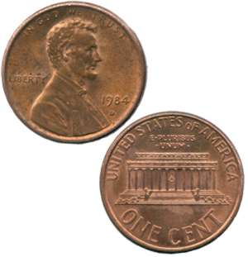
Thinking about Randomness
The result of any single coin toss is random. But the result over many tosses is predictable, as long as the trials are independent (i.e., the outcome of a new coin flip is not influenced by the result of the previous flip).

Slide 6
Uses of Probability
The origins of probability were seventeenth-century games of chance.
In the eighteenth century and the nineteenth century, careful measurements in astronomy and surveying led to further advances in probability due to distributions that arise from random sampling.
Modern applications of probability apply in such diverse fields as
  Traffic flows
  Genetic makeups of a population
  Energy states of subatomic particles
  Spread of epidemics or tweets
  Returns on risky investments

Slide 7
4.2 Probability Models
Sample spaces
Probability rules
Assigning probabilities: Finite number of outcomes
Assigning probabilities: Equally likely outcomes
Independence and the multiplication rule
Applying the probability rules

Slide 8
Probability Models 1
Descriptions of chance behavior contain two parts:
a list of possible outcomes, and
a probability for each outcome.
The sample space S of a random phenomenon is the set of all possible outcomes.
An event is an outcome or a set of outcomes of a random phenomenon. That is, an event is a subset of the sample space.
A probability model is a description of some random phenomenon that consists of two parts: a sample space S and a probability for each outcome.

Slide 9
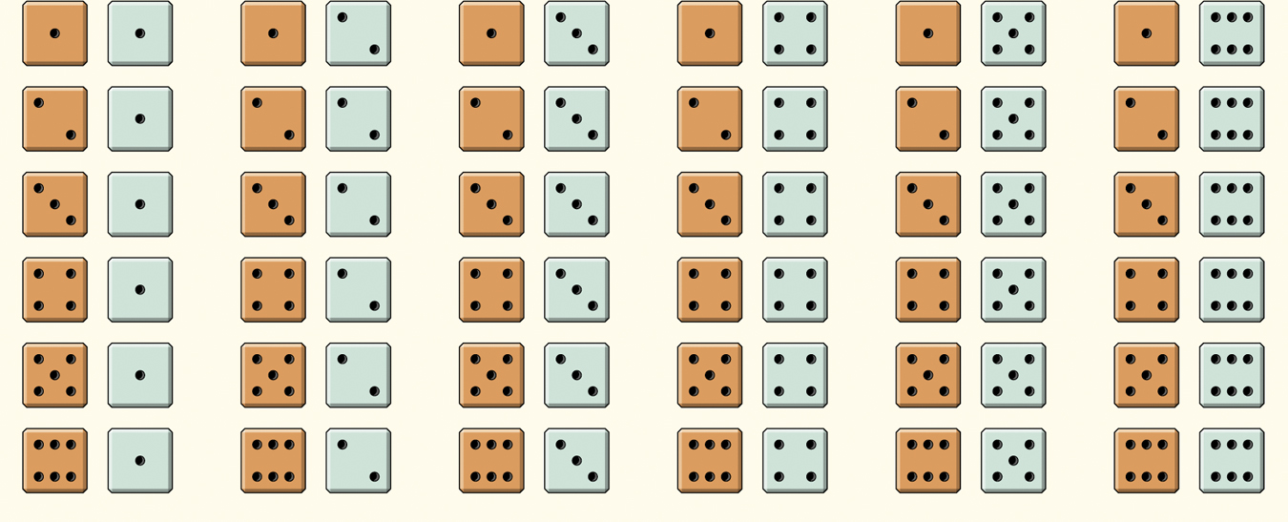
Probability Models 2
Example: Give a probability model for the chance process of rolling two fair, six-sided dice―one that’s red and one that’s green.
Sample Space
36 Outcomes
Because the dice are fair, each
outcome is equally likely.
Each outcome has probability 1/36.

Slide 10
Probability Rules 1
Any probability is a number between 0 and 1.
All possible outcomes together must have probability 1.
If two events have no outcomes in common, the probability that one or the other occurs is the sum of their individual probabilities.
The probability that an event does not occur is 1 minus the probability that the event does occur.
Rule 1. The probability P(A) of any event A satisfies 0 ≤ P(A) ≤ 1.
Rule 2. If S is the sample space in a probability model, then P(S) = 1.
Rule 3. If A and B are disjoint, then P(A or B) = P(A) + P(B).
This is the addition rule for disjoint events.
Rule 4: The complement of any event A is the event that A does not occur, written A^{C}. P(A^{C}) = 1 – P(A).

Slide 11
Probability Rules 2
Example: Favorite vehicle colors. Our preferences for vehicle colors can be related to our personality, our moods, or particular objects. Here is a probability model for color preferences:
Color | White | Black | Silver | Gray
Probability | 0.24 | 0.19 | 0.16 | 0.15
Color | Red | Blue | Brown | Other
Probability | 0.10 | 0.07 | 0.05 | 0.04
(a) Show that this is a legitimate probability model.
  Each probability is between 0 and 1, and
  0.24 + 0.19 + 0.16 + 0.15 + 0.10 + 0.07 + 0.05 + 0.04 = 1
(b) Find the probability that a person’s favorite vehicle color is black or silver.
  P(Black or Silver) = P(Black) + P(Silver)
  = 0.19 + 0.16 = 0.35
(c) Find the probability that a person’s favorite color is not blue.
P(Not Blue) = 1 – P(Blue) = 1 – 0.07 = 0.93

Slide 12
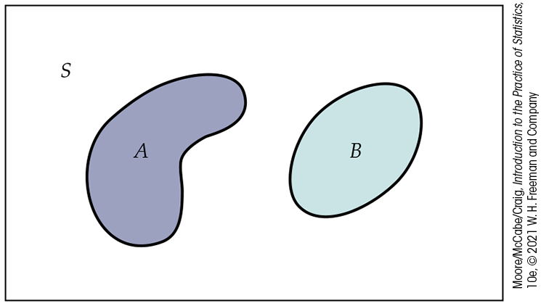
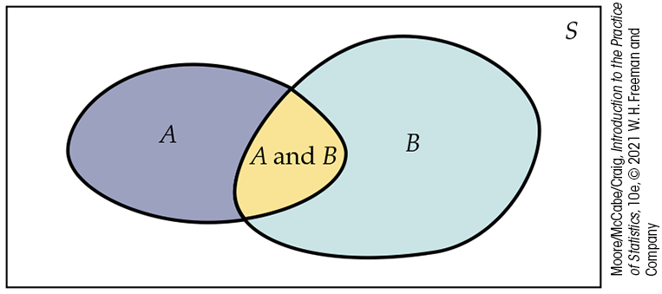
Venn Diagrams (1 of 2)
Sometimes, it is helpful to draw a picture to display relations among several events. A picture that shows the sample space S as a rectangular area and events as areas within S is called a Venn diagram.
Two disjoint events:
Two events that are not disjoint, and the event “A and B” consisting of the outcomes they have in common:

Slide 13
Assigning Probability: Finite Probability Models
One way to assign probabilities to events is to assign a probability to every individual outcome and then add these probabilities to find the probability of any event. This idea works well when there are only a finite (fixed and limited) number of outcomes.
A probability model with a finite sample space is called finite.
To assign probabilities in a finite model, list the probabilities of all the individual outcomes. These probabilities must be numbers between 0 and 1 that add up to exactly 1.
The probability of an event is the sum of the probabilities of the outcomes making up the event.

Slide 14
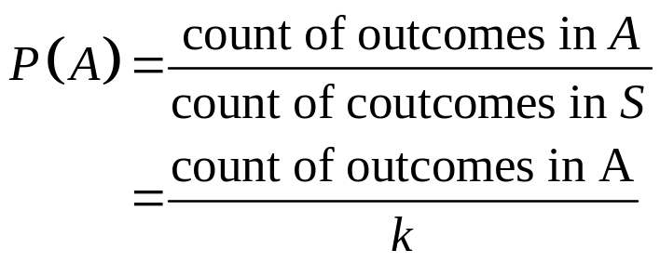
Assigning Probability: Equally Likely Probabilities
In some circumstances, we are willing to assume that individual outcomes are equally likely because of some balance in the phenomenon, such as dice or coins.
Equally Likely Outcomes
If a random phenomenon has k outcomes, all equally likely, then each individual outcome has probability 1/k. The probability of any event A is

Slide 15
Independence and the Multiplication Rule
If two events A and B do not influence each other, and if knowledge about one does not change the probability of the other, the events are said to be independent of each other.
Rule 5: Multiplication Rule for Independent Events
Two events A and B are independent if knowing that one does not change the probability that the other occurs. If A and B are independent, then
P(A and B) = P(A) × P(B)

Slide 16
Applying the Rules
Example: Many people who come to clinics to be tested for HIV do not come back to learn the test results. Clinics now use “rapid HIV tests” that give a result in a few minutes. For the rapid HIV test, the FDA has established 2% as the maximum false-positive rate allowed. If a clinic uses a test that meets the FDA standard and tests 50 people who are HIV-free, what is the probability that at least one false positive will occur?
It is reasonable to assume that the results for different people are independent.
The probability that the test is positive for a single individual is 0.02, so the probability of a negative result is 1 – 0.02 = 0.98 (by the complement rule).
The probability of 50 such negative results is 0.98⁵⁰ = 0.3642 (by the multiplication rule for independent events).
Thus, the probability of at least one false positive among the 50 people tested is 1 – 0.3642 = 0.6358 (again using the complement rule).

Slide 17
4.3 Random Variables
Random variable
Discrete random variables
Continuous random variables
Normal distributions as probability distributions

Slide 18
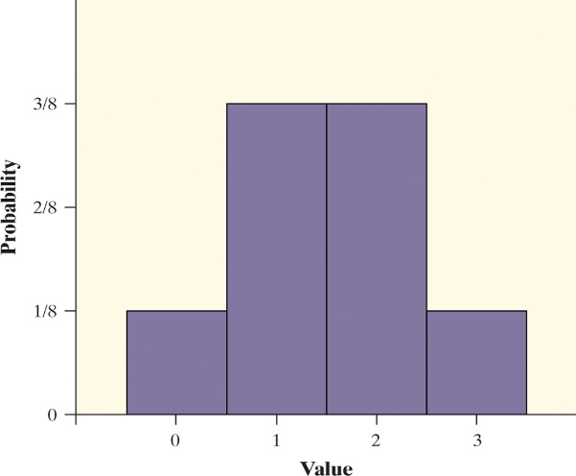
Random Variables
A probability model describes the possible outcomes of a chance process and the likelihood that those outcomes will occur.
A random variable takes numerical values that describe the outcomes of some chance process.
The probability distribution of a random variable gives its possible values and their probabilities.
Example: Consider tossing a fair coin three times.
Define X as the number of heads obtained.
X = 0: TTT
X = 1: HTT THT TTH
X = 2: HHT HTH THH
X = 3: HHH
Value | 0 | 1 | 2 | 3
Probability | 1/8 | 3/8 | 3/8 | 1/8

Slide 19
Discrete Random Variables 1
There are two main types of random variables: discrete and continuous.
If you can find a way to list all possible outcomes for a random variable and assign probabilities to each one, then you have a discrete random variable.
A discrete random variable X takes a fixed set of possible values with gaps between. The probability distribution of a discrete random variable X lists the values x_{i} and their probabilities p_{i}:
Value: x₁ x₂ x₃ …
Probability: p₁ p₂ p₃ …
The probabilities p_{i} must satisfy two requirements:
Every probability p_{i} is a number between 0 and 1.
The sum of the probabilities is 1.
To find the probability of any event, add the probabilities p_{i} of the particular values x_{i} that make up the event.

Slide 20
Discrete Random Variable 2
Example: A liberal arts college posts the grade distribution for its courses. In a recent semester, students in one section of English 130 received 32% A’s, 42% B’s, 19% C’s, 3% D’s, and 4% F’s.
Here is the distribution of the discrete random variable called “Grade Points,” where A = 4, B = 3, etc.:
Value: 0 1 2 3 4
Probability: 0.04 0.03 0.19 0.42 0.32
What is the probability that a randomly selected student got a B or better?
P(X ≥ 3) = P(X = 3) + P(X = 4) = 0.42 + 0.32 = 0.74

Slide 21
Continuous Random Variables
Discrete random variables commonly arise from situations that involve counting something. Situations that involve measuring something often result in a continuous random variable.
A continuous random variable Y takes on all values in an interval of numbers. The probability distribution of Y is described by a density curve.
The probability of any event is the area under the density curve and above the values of Y that make up the event.
Unlike the probability model of a discrete random variable X that assigns a probability between 0 and 1 to each possible value of X, a continuous random variable Y has infinitely many possible values.
All continuous probability models assign probability 0 to every individual outcome. Only intervals of values have positive probability.

Slide 22
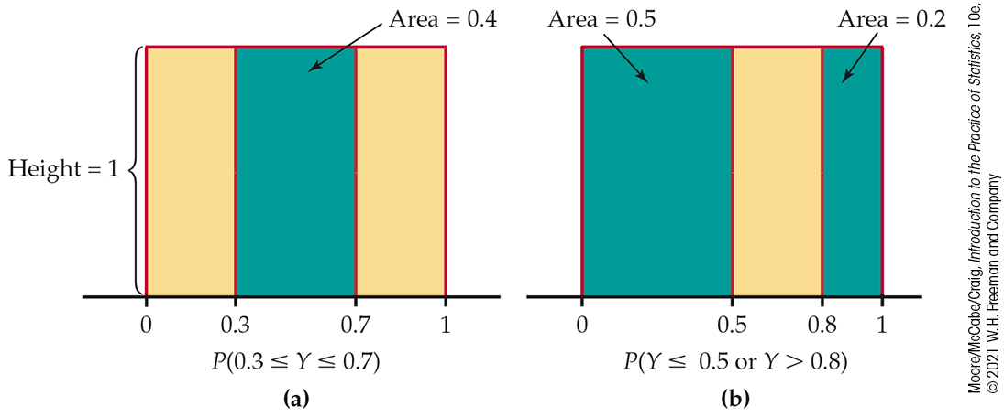
Continuous Probability Models
Suppose we want to choose a number at random between 0 and 1, allowing any number between 0 and 1 as the outcome. We cannot assign probabilities to each individual value, because there is an infinite interval of possible values.
A continuous probability model assigns probabilities as areas under a density curve. The area under the curve and above any range of values is the probability of an outcome in that range.
Example: Find the probability of getting a random number that is less than or equal to 0.5 OR greater than 0.8.
Uniform
distribution
P(X ≤ 0.5 or X > 0.8)
= P(X ≤ 0.5) + P(X > 0.8)
= 0.5 + 0.2
= 0.7

Slide 23
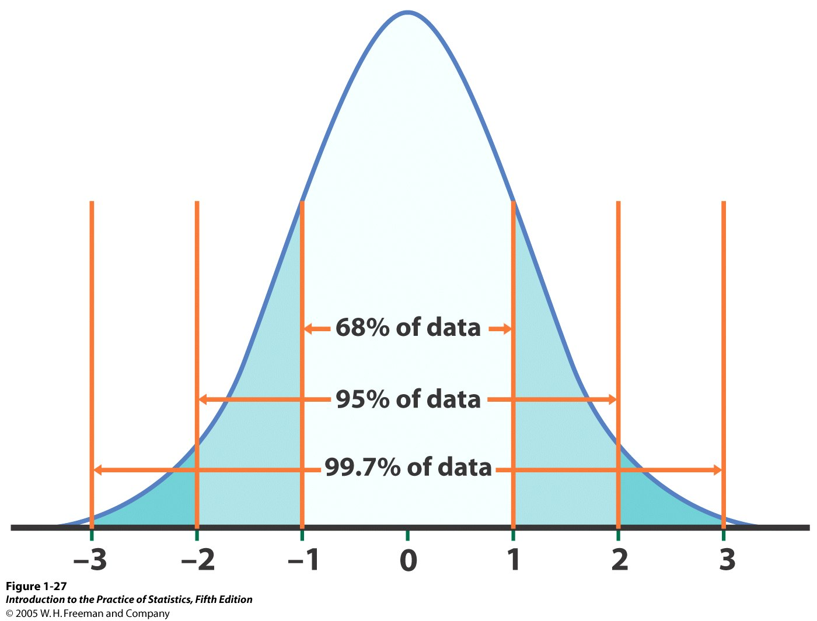
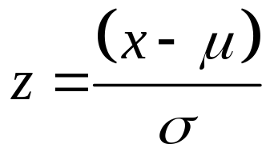

Normal Probability Models 1
Often, the density curve used to assign probabilities to intervals of outcomes is the Normal curve.
Normal distributions are probability models.
Probabilities can be assigned to intervals of outcomes using the standard Normal probabilities in Table A.
We standardize Normal data by calculating z-scores so that any Normal curve N(μ, σ) can be transformed into the standard Normal curve N(0, 1).

Slide 24
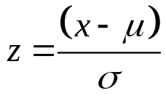
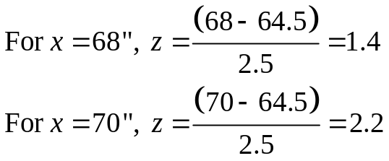
Normal Probability Models 2
Often the density curve used to assign probabilities to intervals of outcomes is the Normal curve.
Example: Women’s heights are Normally distributed with mean 64.5 and standard deviation 2.5 inches. If we pick one woman at random, what is the probability that her height, X, will be between 68 inches and 70 inches? That is, compute P(68 < X < 70).
Because the woman is selected at random, X is a random variable.
Calculate the z-scores for 68 and 70:
Therefore,
P(68 < X < 70) = P(1.4 < Z < 2.2)
= P(Z < 2.2) – P(Z < 1.4)
= 0.986 – 0.919 = 0.067

Slide 25
4.4 Means and Variances of Random Variables
The mean of a random variable
Statistical estimation and the law of large numbers
Rules for means
The variance of a random variable
Rules for variances and standard deviations

Slide 26
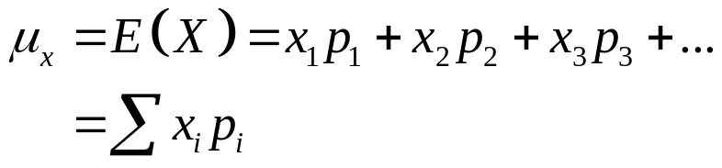
The Mean of a Random Variable
When analyzing discrete random variables, we will follow the same strategy we used with quantitative data―describe the shape, center, and spread, and identify any outliers.
The mean of a discrete random variable is the average of the possible outcomes, with each outcome weighted by its probability.
Mean of a Discrete Random Variable
Suppose that X is a discrete random variable whose probability distribution is
Value: x₁ x₂ x₃ …
Probability: p₁ p₂ p₃ …
To find the mean (expected value) of X, multiply each value by its probability, and then add all the products:

Slide 27
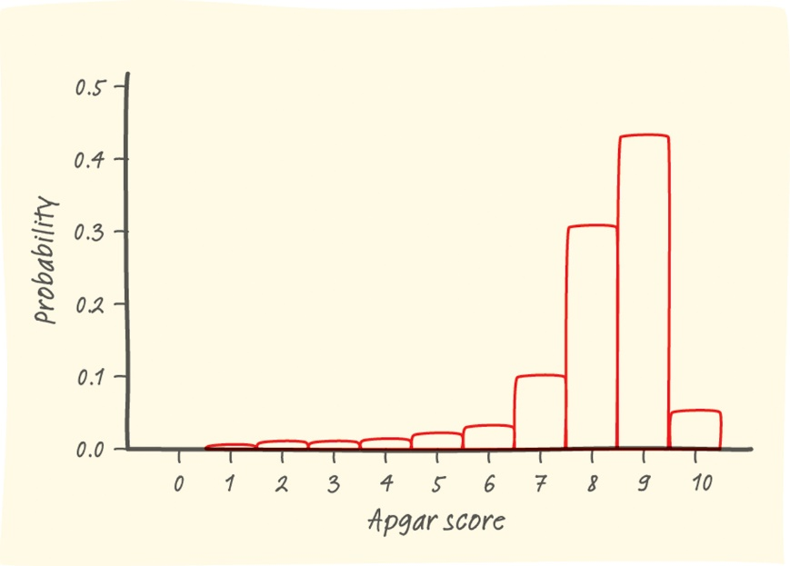
Example: Babies’ Health at Birth
The probability distribution for X = Apgar score is shown below.
Show that the probability distribution for X is legitimate.
Make a histogram of the probability distribution. Describe what you see.
Apgar scores of 7 or higher indicate a healthy baby. What is P(X ≥ 7)?
Value: | 0 | 1 | 2 | 3 | 4 | 5 | 6 | 7 | 8 | 9 | 10
Probability: | 0.001 | 0.006 | 0.007 | 0.008 | 0.012 | 0.020 | 0.038 | 0.099 | 0.319 | 0.437 | 0.053
a. All probabilities are between 0 and 1, and they add up to 1.
This is a legitimate probability distribution.
c. P(X ≥ 7) = 0.908,
so there is a 91% chance of randomly choosing a healthy baby.
b. The left-skewed shape of the distribution suggests that a randomly selected newborn will have an Apgar score at the high end of the scale. There is a small chance of getting a baby with a score of 5 or lower.
27

Slide 28
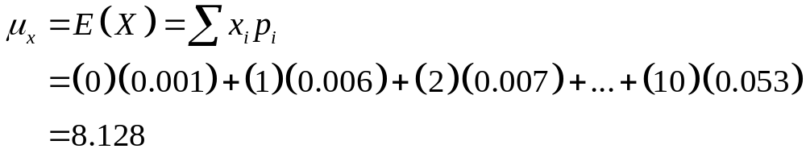
Example: Apgar Scores―What’s Typical?
Consider the random variable X = Apgar score.
Compute the mean of the random variable X and interpret it in context.
Value: | 0 | 1 | 2 | 3 | 4 | 5 | 6 | 7 | 8 | 9 | 10
Probability: | 0.001 | 0.006 | 0.007 | 0.008 | 0.012 | 0.020 | 0.038 | 0.099 | 0.319 | 0.437 | 0.053
The mean Apgar score of a randomly selected newborn is 8.128. This is the long-term average Apgar score of many, many randomly chosen babies.
Note: The expected value does not need to be a possible value of X or an integer! It is a long-term average over many repetitions.

Slide 29
Statistical Estimation
Suppose we would like to estimate an unknown µ. We could select an SRS and base our estimate on the sample mean. However, a different SRS would probably yield a different sample mean.
This basic fact is called sampling variability: The value of a statistic varies in repeated random sampling.
To make sense of sampling variability, we ask:
“What would happen if we took many samples?”
Population
Sample
Sample
Sample
?
Sample
Sample
Sample
Sample
Sample

Slide 30
The Law of Large Numbers
Draw independent observations at random from any population with finite mean µ. The law of large numbers says that as the number of observations drawn increases, the sample mean of the observed values gets closer and closer to the mean µ of the population.
NOTE: The law of SMALL numbers does not hold:
We expect even short sequences of random events to show the kind
of average behavior that, in fact, appears only in the long run.
Our intuition does not do a good job of distinguishing random behavior from systematic influences. This is why we need statistical inference procedures, so we can verify that what we see in the data is more than a random pattern.

Slide 31
Rules for Means
Rules for Means
Rule 1: If X is a random variable and a and b are fixed numbers, then
          µ_{a+bX} = a + bµ_{X}
Rule 2: If X and Y are random variables, then
          µ_{X+Y} = µ_{X} + µ_{Y}
Rule 3: If X and Y are random variables, then
          µ_{X–Y} = µ_{X} – µ_{Y}
Example: The crickets living in a field have a mean length of 1.2 inches. What is the mean in centimeters?
There are 2.54 cm in an inch, so the mean length in inches is multiplied by 2.54: 1.2 x 2.54 = 3.05 cm. (Note that we used Rule 1 with b = 1.2. There was no a for this situation.)

Slide 32
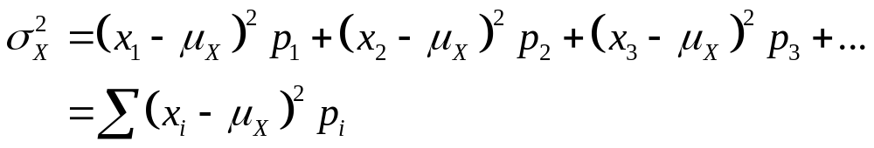
Variance of a Random Variable
Because we use the mean as the measure of center for a discrete random variable, we’ll use the standard deviation as our measure of spread.
The definition of the variance of a random variable is similar to the definition of the variance for a set of quantitative data.
Variance of a Discrete Random Variable
Suppose that X is a discrete random variable whose probability distribution is
Value: x₁ x₂ x₃ …
Probability: p₁ p₂ p₃ …
and that µ_{X} is the mean of X. The variance of X is
To get the standard deviation of a random variable, take the square root of the variance.

Slide 33
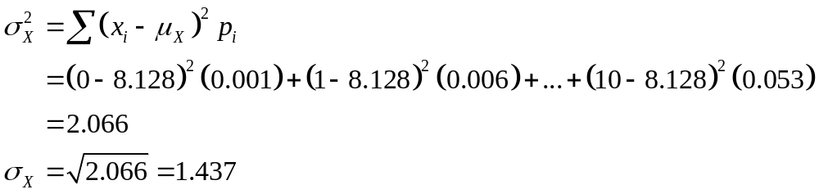
Example: Apgar Scores―How Variable Are They?
Consider the random variable X = Apgar score
Compute the standard deviation of the random variable X and interpret it in context.
Value: | 0 | 1 | 2 | 3 | 4 | 5 | 6 | 7 | 8 | 9 | 10
Probability: | 0.001 | 0.006 | 0.007 | 0.008 | 0.012 | 0.020 | 0.038 | 0.099 | 0.319 | 0.437 | 0.053
Variance
The standard deviation of X is 1.437. This means that, on average, a randomly selected baby’s Apgar score will differ from the mean 8.128 by about 1.4 units.

Slide 34
Rules for Variances
Rules for Variances and Standard Deviations
Rule 1: If X is a random variable and a and b are fixed numbers, then
          σ²_{a+bX} = b²σ²_{X}
Rule 2: If X and Y are independent random variables, then
          σ²_{X+Y} = σ²_{X} + σ²_{Y}
          σ²_{X–Y} = σ²_{X} + σ²_{Y}
Rule 3: If X and Y have correlation ρ, then
          σ²_{X+Y} = σ²_{X} + σ²_{Y} + 2ρσ_{X}σ_{Y}
          σ²_{X–Y} = σ²_{X} + σ²_{Y} ̶ 2ρσ_{X}σ_{Y}

Slide 35
4.5 General Probability Rules
Probability rules
General addition rules
Conditional probability
General multiplication rules
Tree diagrams
Bayes’s rule
Independence again

Slide 36
Probability Rules
Our study of probability has concentrated on random variables and their distributions. Now we return to the laws that govern any assignment of probabilities.
Rule 1. The probability P(A) of any event A satisfies 0 ≤ P(A) ≤ 1.
Rule 2. If S is the sample space in a probability model, then P(S) = 1.
Rule 3. If A and B are disjoint, then P(A or B) = P(A) + P(B).
Rule 4. For any event A, P(A^{C}) = 1 – P(A).
Rule 5. If A and B are independent, then P(A and B) = P(A)P(B).

Slide 37
Venn Diagrams (2 of 2)
Sometimes, it is helpful to draw a picture to display relations among several events. A picture that shows the sample space S as a rectangular area and events as areas within S is called a Venn diagram.
Two events that are not disjoint, and the event “A and B” consisting of the outcomes they have in common:
Two disjoint events:

Slide 38
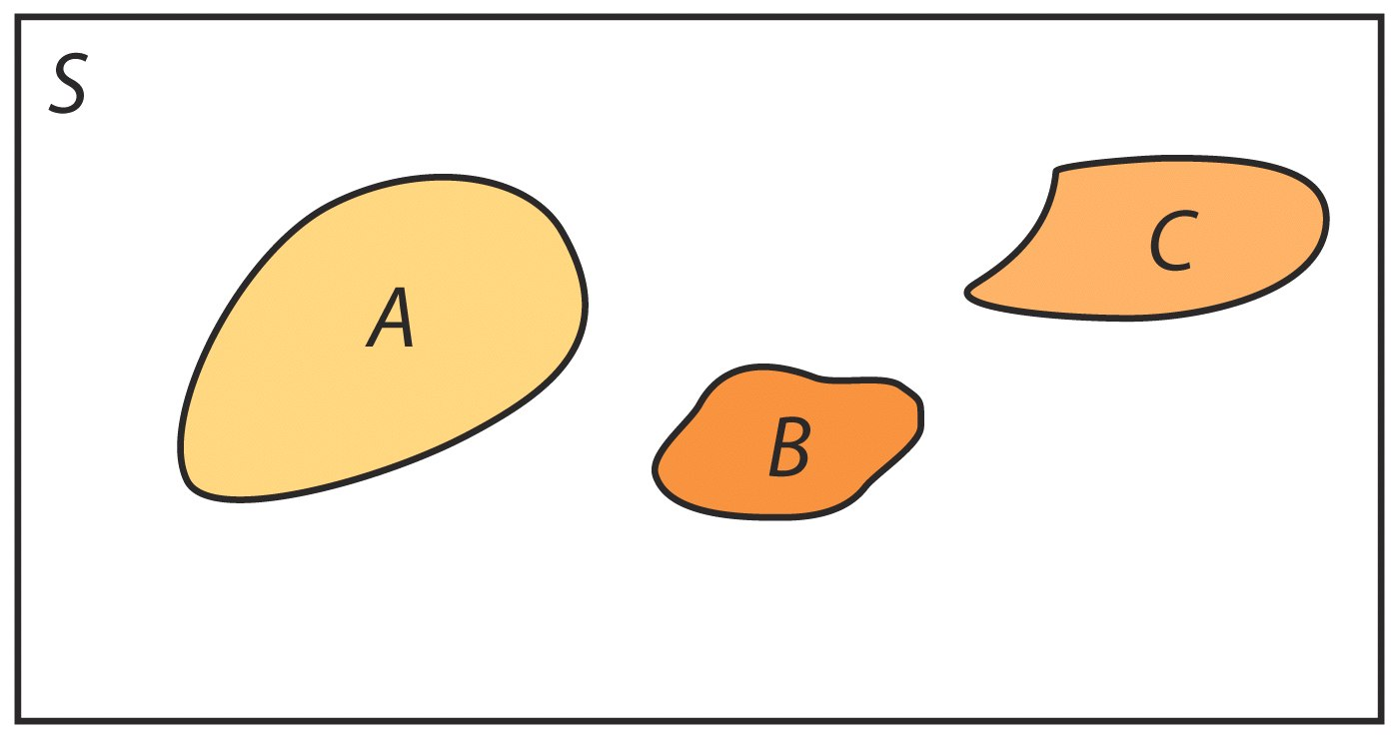
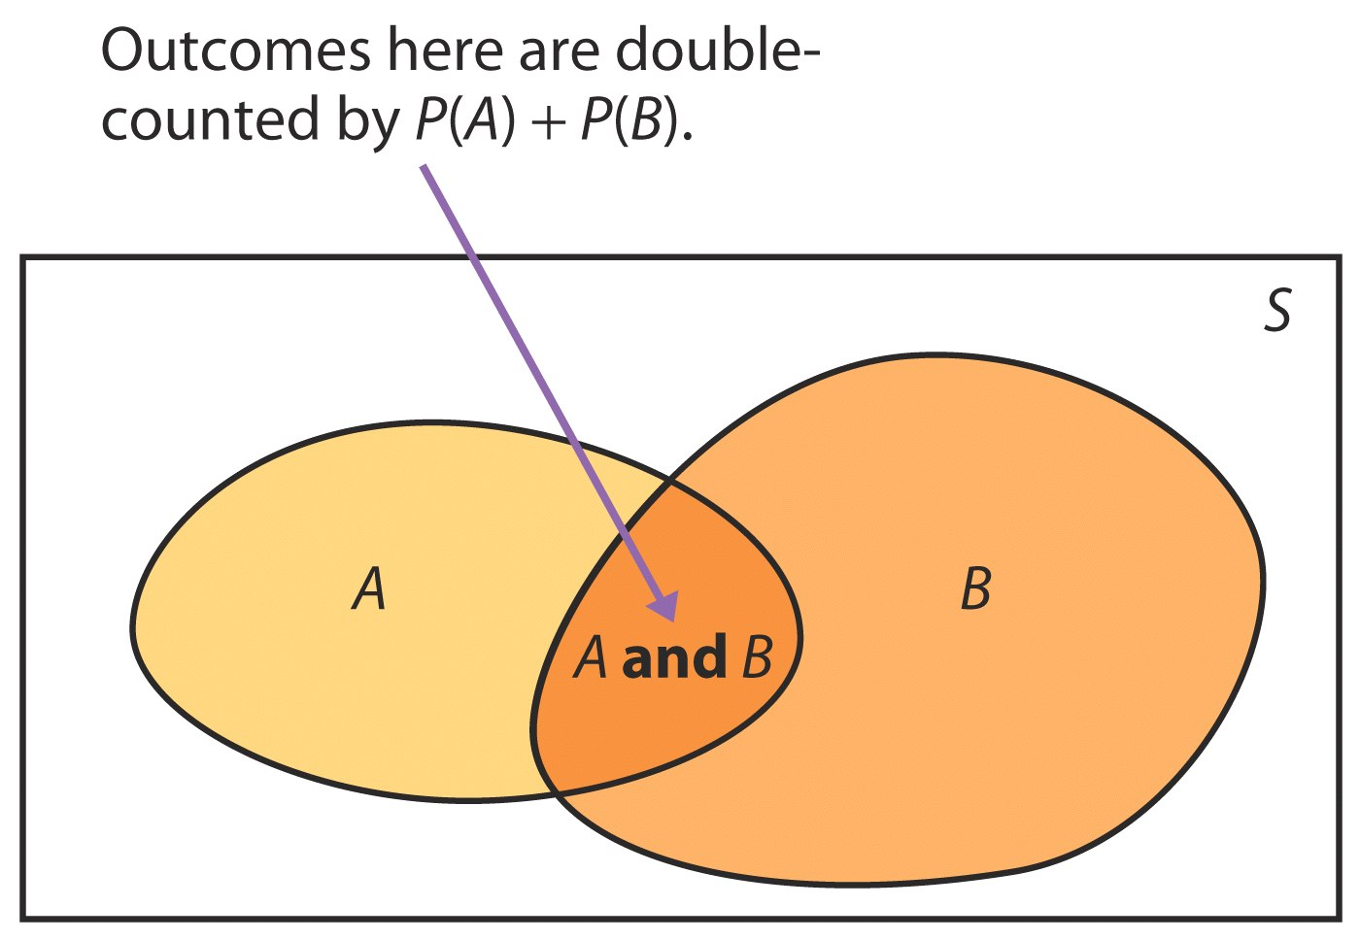
The General Addition Rule
Addition Rule for Disjoint Events
If A and B are disjoint in the sense that no two have any outcomes in common, then
P(A or B) = P(A) + P(B)
Addition Rule for Unions of Two Events
For any two events A and B:
P(A or B) = P(A) + P(B) – P(A and B)

Slide 39
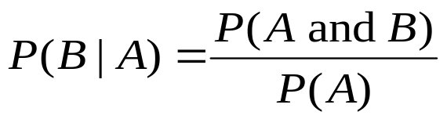
Conditional Probability
The probability we assign to an event can change if we know that some other event has occurred. This idea is the key to many applications of probability.
When we are trying to find the probability that one event will happen under the condition that some other event is already known to have occurred, we are trying to determine a conditional probability.
The probability that one event happens given that another event is already known to have happened is called a conditional probability.
When P(A) > 0, the probability that event B happens given that event A has happened is found by

Slide 40
The General Multiplication Rule
The definition of conditional probability reminds us that in principle, all probabilities, including conditional probabilities, can be found from the assignment of probabilities to events that describe a random phenomenon.
The definition of conditional probability then turns into a rule for finding the probability that both of two events occur.
The probability that events A and B both occur can be found using the general multiplication rule:
P(A and B) = P(A) • P(B | A)
where P(B | A) is the conditional probability that event B occurs given that event A has already occurred.

Slide 41
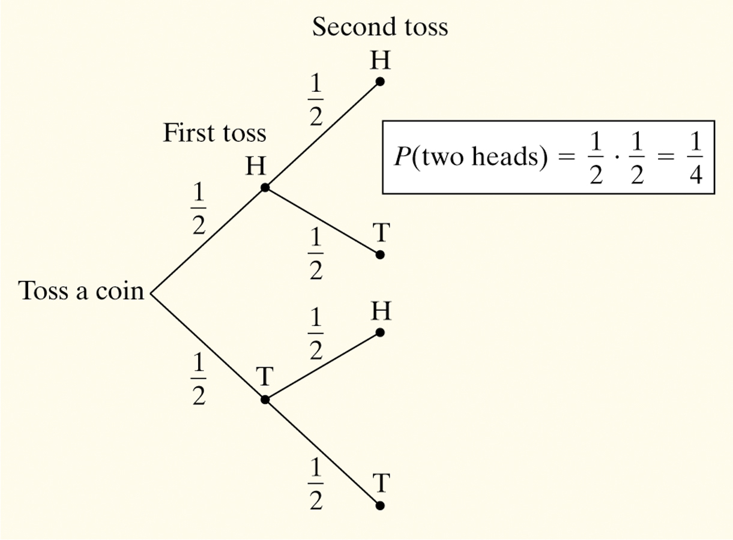
Tree Diagrams
Probability problems often require us to combine several of the basic rules into a more elaborate calculation. One way to model chance behavior that involves a sequence of outcomes is to construct a tree diagram.
Example: Consider flipping a coin twice.
What is the probability of getting two heads?
Sample Space
HH HT TH TT
Therefore,
P(two heads) = P(HH)
= 1/4

Slide 42
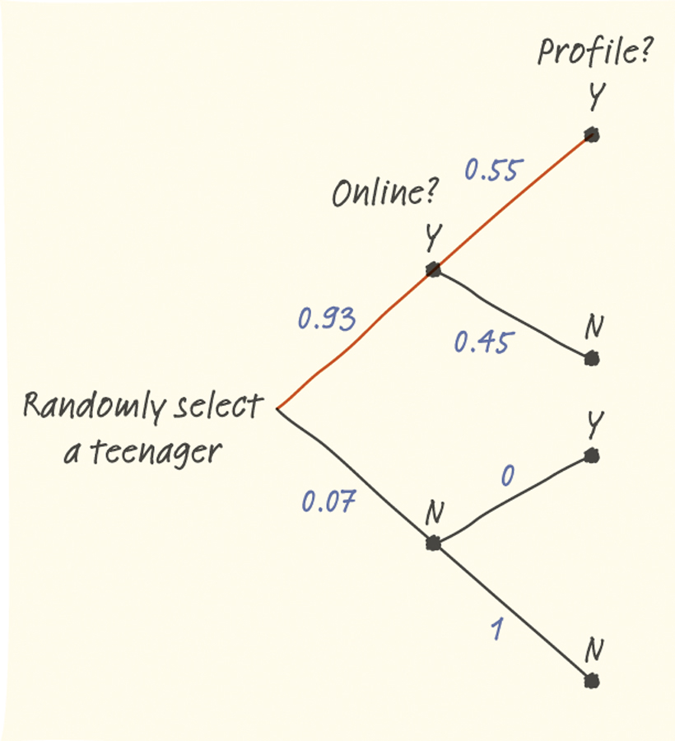
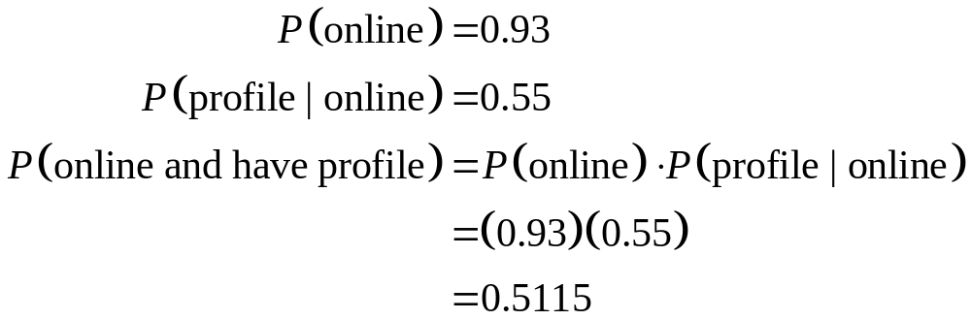
Tree Diagrams Example
Example: The Pew Internet and American Life Project finds that 93% of teenagers (ages 12 to 17) use the Internet and that 55% of online teens have posted a profile on a social-networking site.
What percent of teens are online and have posted a profile?
Therefore, 51.15% of teens are online and have posted a profile.

Slide 43
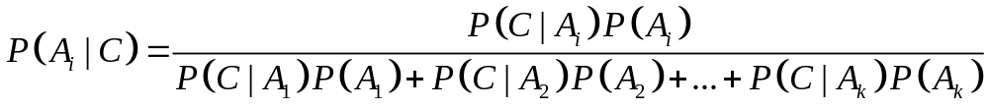
Bayes’s Rule
An important application of conditional probabilities is Bayes’s rule.
Suppose that a sample space is decomposed into k disjoint events A₁, A₂, …, A_{k} — none of which has a 0 probability — such that P(A₁) + P(A₂) + … + P(A_{k}) = 1.
Let C be any other event such that P(C) is not 0. Then
However, it is often intuitively much easier to work out answers with a probability tree than with this lengthy formula.

Slide 44


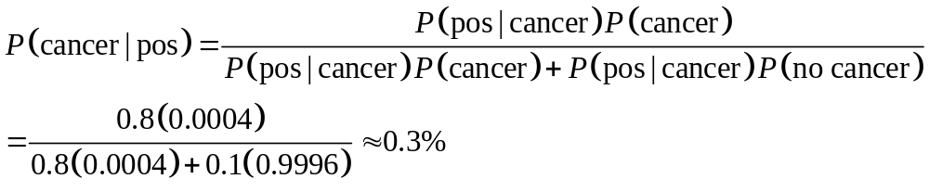
Bayes’s Rule Example
44
Example: If a woman in her 20s gets screened for breast cancer and receives a positive test result, what is the probability that she does have breast cancer?
Diagnosis sensitivity
Disease incidence
0.8
Positive
Cancer
0.0004
Negative
False negative
0.2
Mammography
0.1
0.9996
Positive
False positive
Incidence of breast cancer among women ages 20–30
No cancer
0.9
Negative
Diagnosis specificity
Mammography performance
$A_{1}$ is cancer, $A_{2}$ is no cancer, and C is a positive test.

Slide 45
Independence Again
If two events A and B do not influence each other, and if knowledge about one does not change the probability of the other, the events are said to be independent of each other.
Multiplication Rule for Independent Events
Two events A and B are independent if knowing that one occurs does not change the probability that the other occurs. If A and B are independent, then
P(A and B) = P(A) × P(B)
Note: Two events A and B that both have positive probability are also independent if
P(B|A) = P(B)

Slide 46
Chapter 4
Probability: The Study of Randomness (Review)
4.1 Randomness
4.2 Probability Models
4.3 Random Variables
4.4 Means and Variances of Random Variables
4.5 General Probability Rules

